Slide 1

Sensory-Evoked Potentials
„Introduction to EEG“
By Stephi Irving

Slide 2
General Info
An evoked potential is an electrical potential from the nervous system following the presentation of sensory stimuli. It is distinct from spontaneous potentials.
Sensory-evoked potential (SEP) describes the responses of the sensory pathways to sensory or electrical stimuli (auditory, visual, somatosensory).
The basic principles of SEP monitoring involves identification of a neurologic region at risk, selection and stimulation of a nerve that carries a signal through the at-risk region, and recording and interpreting the signal at certain standardised points along the pathway.

Slide 3

General Info
SEPs are obtained by stimulating with an electrical impulse, which is then recorded from the scalp.
Mostly used in the operating theatre and clinical research. Intra-operative monitoring of SEPs is used to assess the functional integrity of CNS pathways during operations that put the spinal cord or brain at risk.
Amplitudes tend to be low and noise levels are high (background EEG, scalp muscle EMG, electrical devices nearby, etc.). Therefore the signal must be averaged.
Averaging improves the signal-to-noise ratio. During surgery, 100-1,000 averages are used to resolve the evoked potential.

Slide 4
Methods
Peripheral nerves, such as the median, ulnar, peroneal, or tibial nerves, are typically stimulated.
Recording is done either cortically or at the level of the spinal cord above the surgical procedure.
Intra-operative monitoring of SEPs is most commonly used during surgery:
In monitoring patients undergoing corrective surgery, e.g. scoliosis.
Several different techniques are commonly used, including stimulation of a relevant peripheral nerve with monitoring from the scalp, from interspinous ligament needle electrodes, or from catheter electrodes in the epidural space.
Brainstem auditory-evoked potentials (BAEPs) are generated in response to auditory clicks and can define the functional status of the auditory nerve.
Visual-evoked potentials (VEPs) with light flashes are used to track visual signals from the retina to the occipital cortex. VEP monitoring has been used for surgery on lesions near the optic chiasm.

Slide 5

Somatosensory-evoked potentials
Stimulus: electrical-square wave pulse by surface or needle electrode.
Duration: 100-300 micro seconds at a rate of 3-7 stimuli per second.
Sites: ERB‘s point (N9), C2 or C5 (cervical spine), C3 or C4 (contralateral cortex).
Reference: forehead Fz

Slide 6

SEPs
SEPs are characterised by both amplitude (magnitude of response) and latency (time from stimulation until response). By convention, downward deflections are positive and upward are negative.
The highest amplitude SEPs are obtained after stimulation of ulnar and median nerves, and the lowest amplitude SEPs are obtained after stimulation of cutaneous or dermatomal nerves.
Similarly in lower limb, tibial nerve produces more reliable SEP than peroneal nerve.

Slide 7
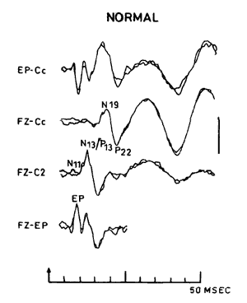
SEPs
Signals are described in terms of the direction of the wave (N or P) and the standard time from stimulus to detection (latency) e.g. for median nerve stimulation, N19/P22 is the parietal sensory cortex.
There are a variety of SEP types produced and those used for monitoring are the short latency responses because they are the most robust.
Any interruptions in this pathway can then be detected by SEP monitoring.

Slide 8
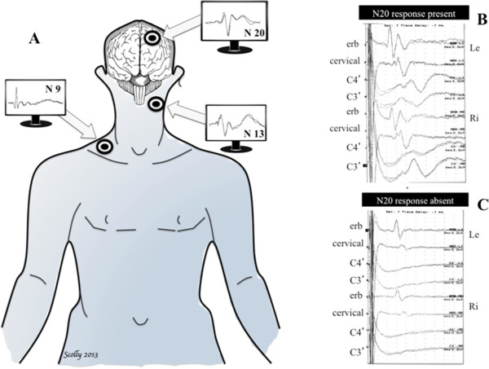
(A) In comatose survivors after cardiac arrest, somatosensory evoked potentials are elicited by transcutaneous electrical stimulation applied to the median nerve and then recorded at Erb’s point (N9), the cervical medulla (N13) and the controlateral cortex (N20). (B) Example of present N20 cortical response (C3’) in two comatose patients after cardiac arrest. (C) Example of absent N20 cortical response (C3’) in two comatose patients after cardiac arrest.

Slide 9
Standard Settings
Stimulus intensity: sufficient to cause a slight muscle twitch, higher used in atrophied limbs (higher intensity is painful and recruit motor > sensory responses).
Stimulus rate: 2-5 Hz for upper extremity stimulation and 1-2 Hz for lower extremity stimulation (rates greater than 10 Hz may cause an increase in latency and decrease in amplitude).
Filter setting: 30-3000 Hz. (Not recommended to use the 60 Hz notch filter because SEP in this range contains important physiologic information).
Pulse width : 100-300 µs
Analysis time: 40 ms for UE and 60 ms for LE.
Amplifier sensitivity: 10 µV for the spine and scalp potentials and 20 µV for peripheral potentials.
Number averaged: 500-2000 for reproducible wave forms (depends on noise).
Electrode impedance: <5000 Ω

Slide 10

Averaging
SEP amplitude is low compared to noise of motor activity, movement artifact, ECG, EEG and electromagnetic activity in the environment.
Averaging summates activity that is time locked to the stimulus trigger while gradually subtracting random background noise.
Most artifacts can be eliminated by averages rejecting sweeps that contain waveforms exceeding fixed maximal amplitudes.

Slide 11

Averaging
Digital values for each time-point are averaged to give a single vector of values.
The residual waveform will represent activity of the temporal relationship to the SEP.
Disadvantages: cannot give estimates of SEPs for single events (e.g. reaction time). Average waveform may not accurately depict the actual waveform recorded.

Slide 12

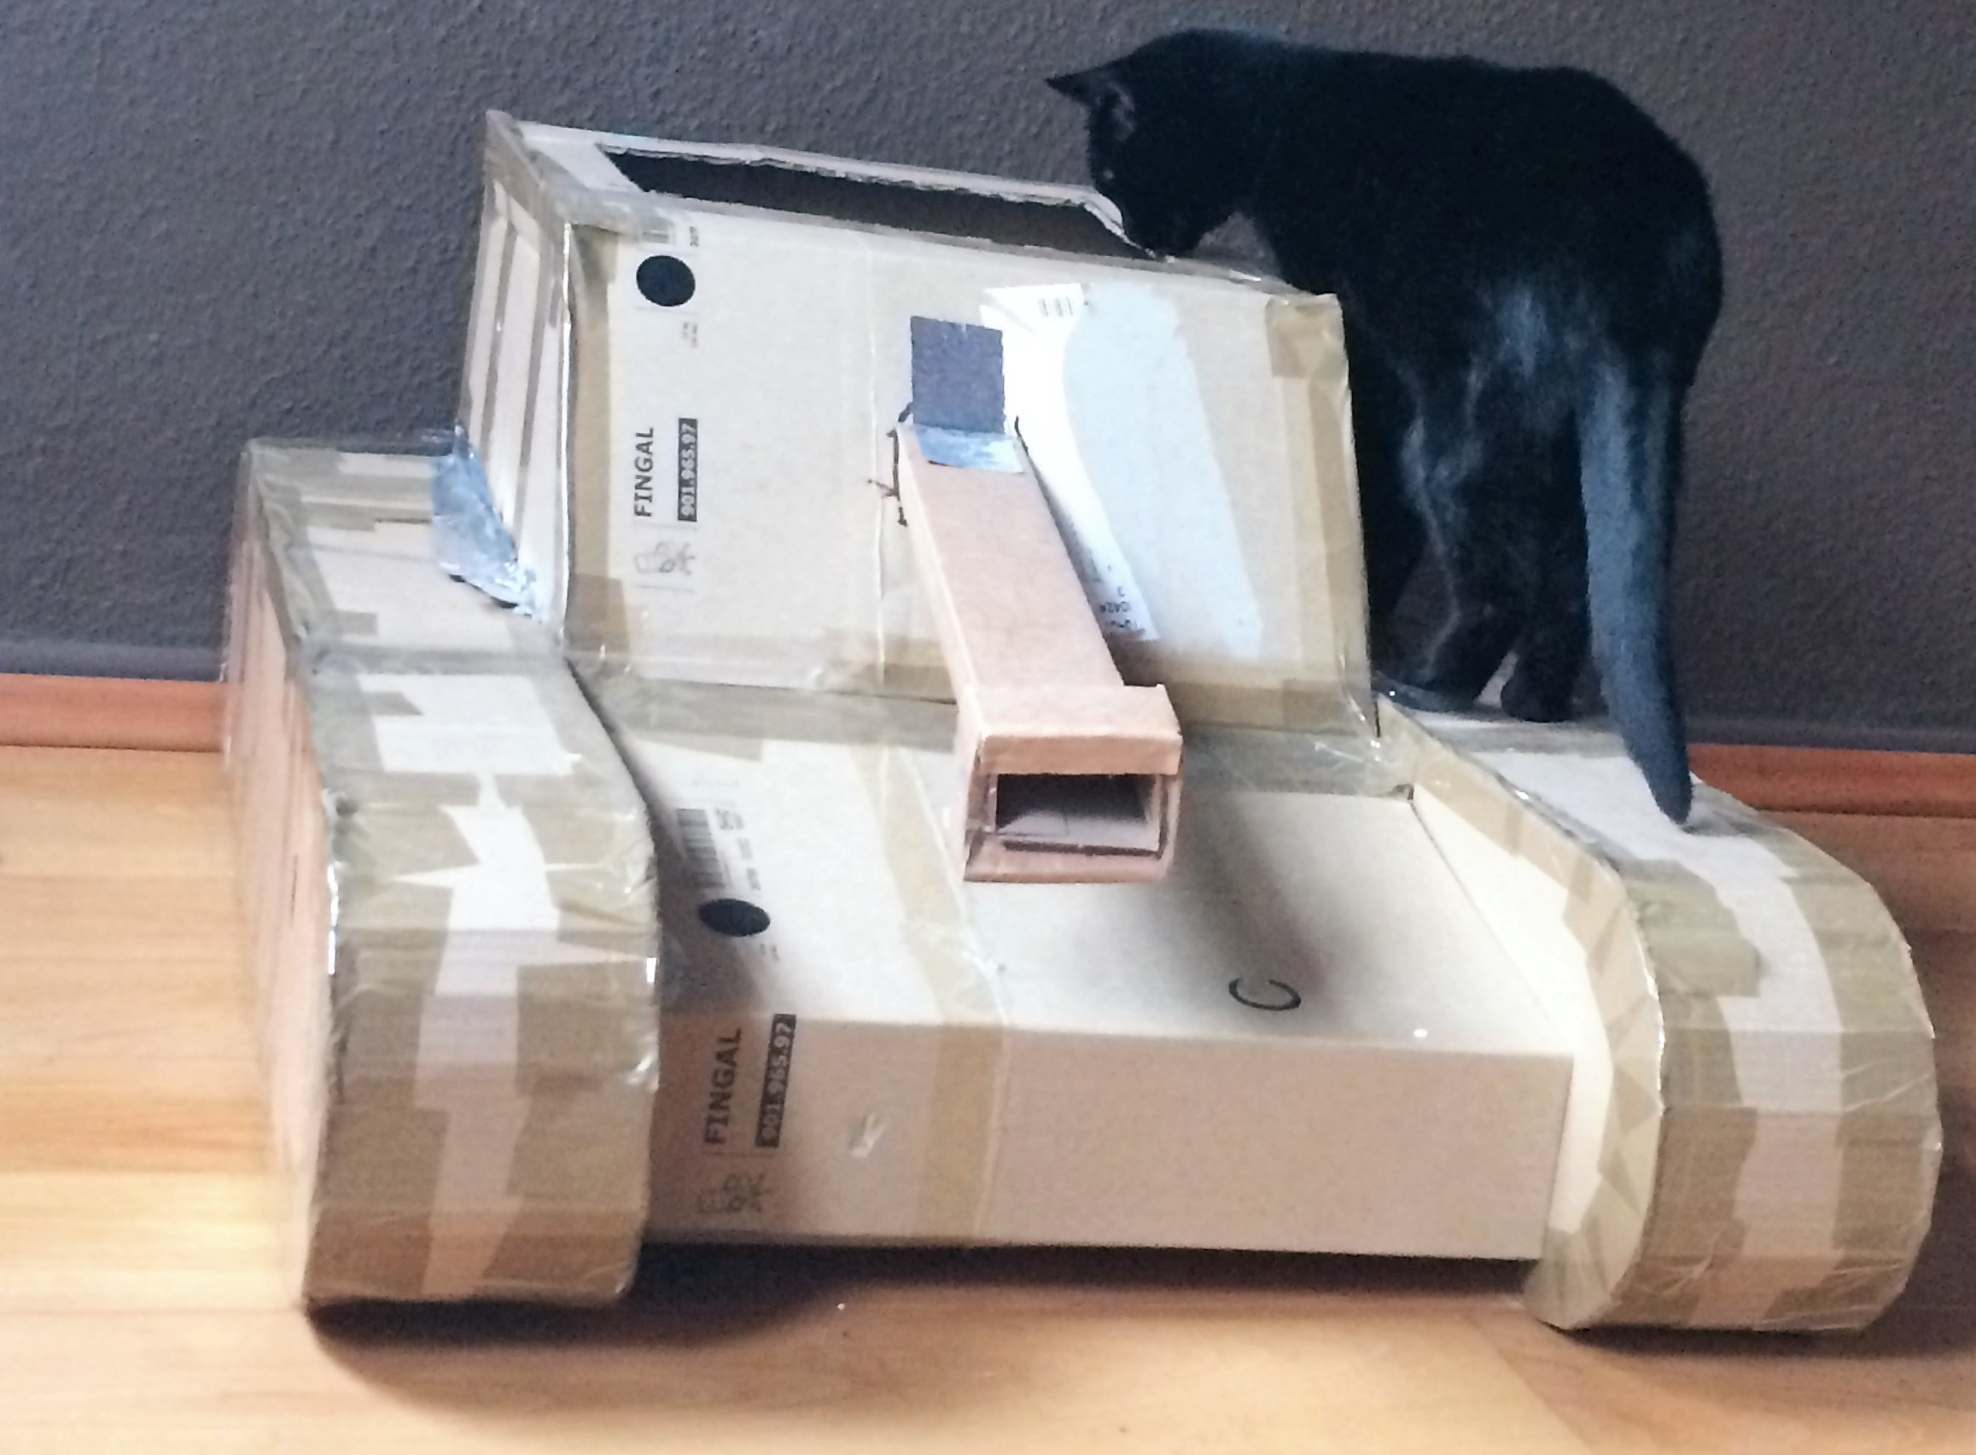
Thank you!

